Slide 1



Slide 2

The drought
Bank failures
Stock market crash of 1929
Reduction in purchasing across the board
American economic policy with europe

Slide 3

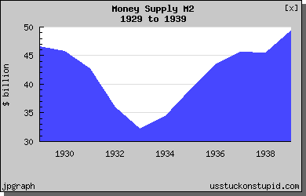

Slide 4

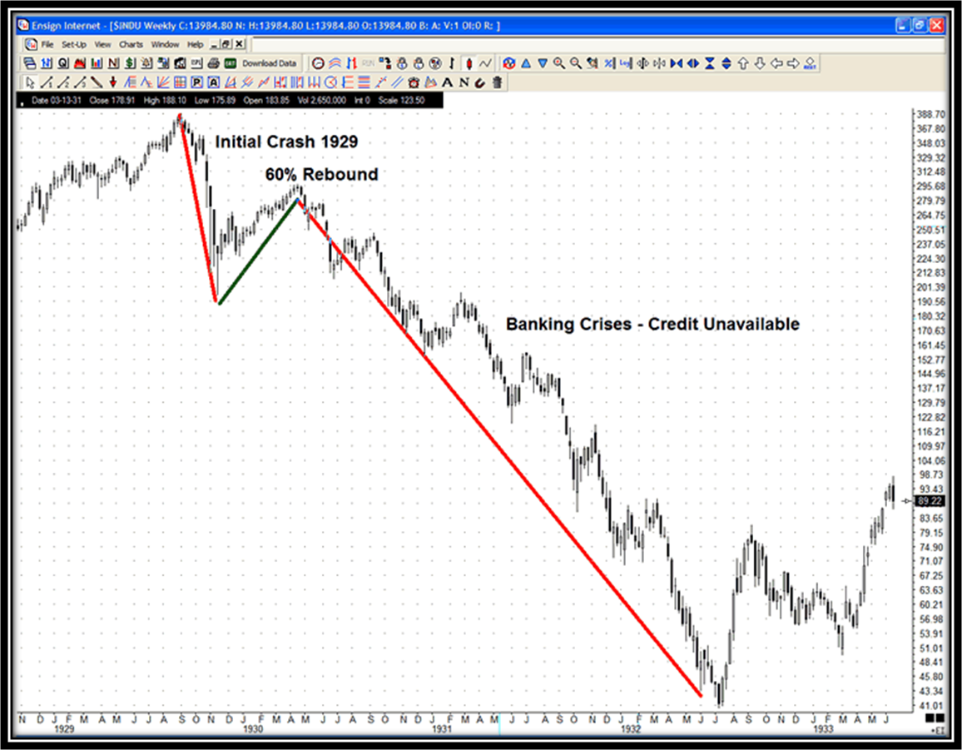

Slide 5
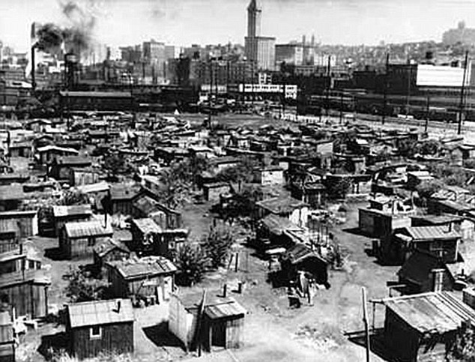

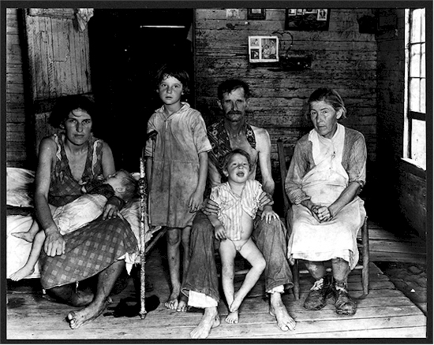
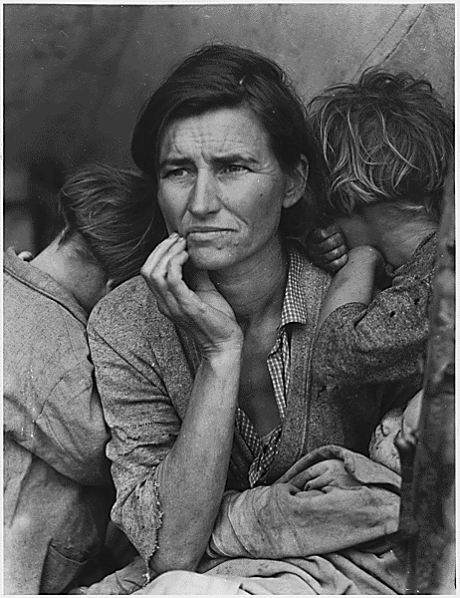
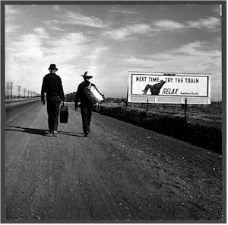

Slide 6

"In America the unemployment rate reached nearly 25% at its peak." - thegreatdepression.co.uk
"Nearly 50% of the children of the great depression did not have adequate food, shelter, or medical care.“ - - stocks-simplified.com
The Dust Bowl: There was a terrible drought which has turned soil into dust. During the Great depression a period of severe dust storms causing major damage to farms. Millions of acres of farmland became useless and hundreds of thousands of people became homeless
World War 2 eventually pulled the US out of the depression by creating new jobs
Between 1929 and 1932 the annual income of an average American family dropped by 40%
During the Great Depression bankers became so unpopular that bank robbers, such as Bonnie and Clyde, became American folk heroes

Slide 7

Drought
Neighbors helped each other
Everyone was poor

Slide 8

Unemployment or pay cuts
Unheated, unsanitary homes
Terror everywhere

Slide 9

Stock market crash
Rich got richer, at the expense of the poor

Slide 10

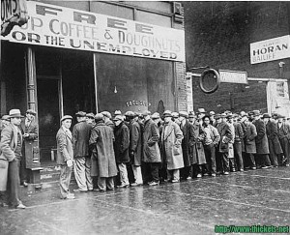
Unemployment
Difficult to find ways to make money

Slide 11

The Great Depression of the 1930s worsened the already bleak economic situation of African Americans. They were the first to be laid off from their jobs, and they suffered from an unemployment rate two to three times that of whites. In early public assistance programs African Americans often received substantially less aid than whites, and some charitable organizations even excluded blacks from their soup kitchens. – Encyclopedia Britannica

Slide 12

The poor were hit the hardest. By 1932, Harlem had an unemployment rate of 50 percent and property owned or managed by blacks fell from 30 percent to 5 percent in 1935. Farmers in the Midwest were doubly hit by economic downturns and the Dust Bowl. Schools, with budgets shrinking, shortened both the school day and the school year. - http://www.nps.gov/archive/elro/glossary/great-depression.htm
They had to live in places called “Hooverville” and they were known for the horrible conditions.

Slide 13

Federal Emergency Relief Administration Civilian Conservation Corps Works Progress Administration Home Owners Loan Corporation

Slide 14

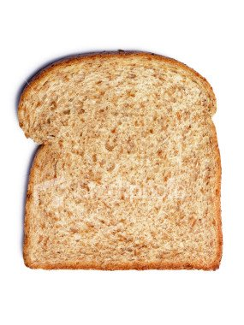
Diet centered around vegetables Little meat (except for chicken) Bread

Slide 15

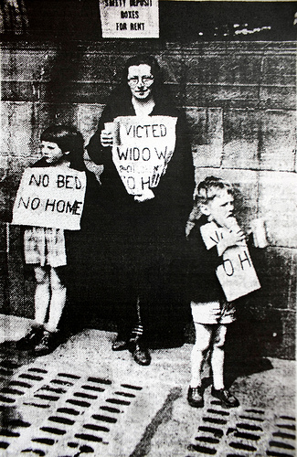
Rent Strikes Eviction Resistance Leads to the United States Housing Act passed by congress in 1937 Establish public housing program

Slide 16

Stealing "Relief lines" Children would chew on their hands until they bled "Have nots" were most suceptible to starvation

Slide 17

Hand me down clothing
make one loaf of bread last a week
Restrict spending to the minimum. Buy only from friends in local businesses who in turn would buy your wares. Save as much as possible but not in banks.
reduce having sexual intercourse to reduce having babies

Slide 18
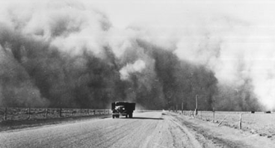

Between 1930 and 1940, the southwestern Great Plains region of the United States suffered a severe drought
Dry land farming on the Great Plains led to the systematic destruction of the prairie grasses.
Winds whipped across the plains, raising billowing clouds of dust. The sky could darken for days, and even well-sealed homes could have a thick layer of dust on the furniture

Slide 19

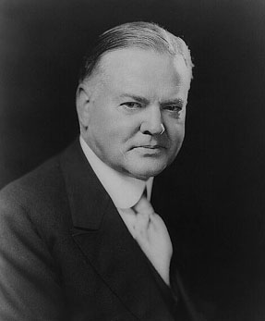
Herbert Hoover (1874-1964), a Republican, was president when the Great Depression began. He infamously declared in March 1930 that the U.S. had “passed the worst” and argued that the economy would sort itself out. The worst, however, had just begun and would last until the outbreak of WWII (1939).
Herbert Hoover was a laissez faire president and that FDR brought us out of the depression.
Herbert Hoover broke with the previous laissez-faire policy for dealing with recessions and depressions.
In the last week of October 1929, he urged the Fed to extend $300 million in quantitative easing

Slide 20

The Red Cross and the government set up stations that gave food and other necessities such as clothes to the needy.
Big and efficient
Had to help cope with the drought

